Slide 1

LINUX
DARSHINI S

Slide 2
What is Unix
Linux is an operating system it act as a link between computer and the user
It is collection of programs
Users communicate with the kernel through a program known as the shell. The shell is a command line interpreter; it translates commands entered by the user and converts them into a language that is understood by the kernel.
It is originally invented in 1969 by a team of Ken Thompson, Dennis Ritchie, Douglas McIlroy, and Joe Ossanna at Bell Labs.

Slide 3
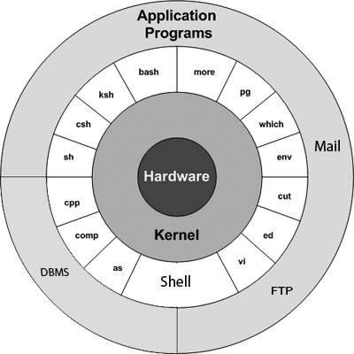
Unix Architecture

Slide 4
SOME USEFUL INITIAL COMMANDS
$ cal
It is used for display the calendar
$ passwd
this command is used to change the current user password
$ whoami
it shows the the current system user name
$ users
it list out the current user list of the same system
$ who
displays information about all users currently on the local system

Slide 5
Linux file types
ordinary file – A file contains text or programming instruction called ordinary files.
Directories – it store ordinary files and special files as group.
Special files – A file which is access CD-Rom and some other hardware components are called special files.

Slide 6
File Management
copying files
Syntax : $cp source file- destination file
Renaming files
Synatx : $mv old_name new_name
Deleting files
Syntax : $rm file.txt
Creating files
Syntax : $vi file.txt
Display content of a file
Syntax : $cat file.txt
Counting words in a file
Syntax : $wc file.txt

Slide 7
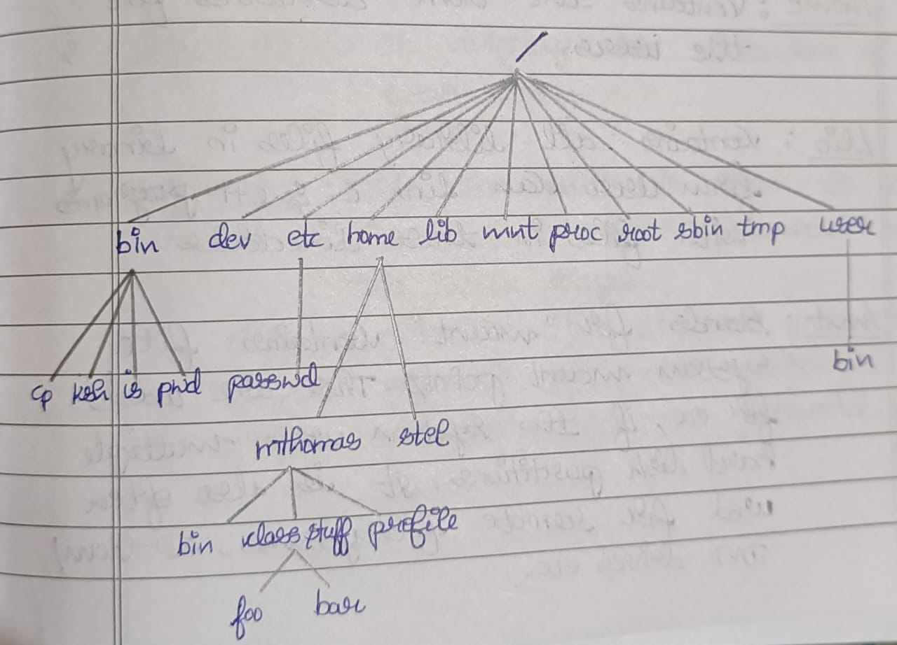
Unix file system
Data-> files->Directories-> file system

Slide 8
Directory Management
Home directory
Syntax : $ cd ~~ indicated home directory
listing directories
Syntax : $ls directory_name
Creating directories
Syntax : mkdir directory_name
Removing directories
Syntax : rmdir directory_name
Changing directories
Syntax : cd directory_name
Renaming directories
Syntax : mv old_directory_name new_directory_name

Slide 9
File Permission
Owner permissions − The owner's permissions determine what actions the owner of the file can perform on the file.
Group permissions − The group's permissions determine what actions a user, who is a member of the group that a file belongs to, can perform on the file.
Other (world) permissions − The permissions for others indicate what action all other users can perform on the file.

Slide 10
File Access Modes
r- read
w- write
x – execute
drwxrwxrwx 5 hamsagowda hamsagowda 4096 Jun 21 11:35 django
In that first character indicates the file type
d (directory)
- (file)
character from 2 to 4 specify the owners permissions
character from 5 to 7 specify the group permissions
character from 8 to 10 specify the others permissions

Slide 11
Directory Access Modes
Read
Access to a directory means that the user can read the contents. The user can look at the
filenames inside the directory.
Write
Access means that the user can add or delete files from the directory.
Execute
Executing a directory doesn't really make sense, so think of this as a traverse permission.

Slide 12
Changing Permissions
1. symbolic mode
2. absolute permissions
Number | Octal Permission Representation | Ref
0 | No permission | ---
1 | Execute permission | --x
2 | Write permission | -w-
3 | Execute and write permission: 1 (execute) + 2 (write) = 3 | -wx
4 | Read permission | r--
5 | Read and execute permission: 4 (read) + 1 (execute) = 5 | r-x
6 | Read and write permission: 4 (read) + 2 (write) = 6 | rw-
7 | All permissions: 4 (read) + 2 (write) + 1 (execute) = 7 | rwx

Slide 13
FILTERS
grep
Syntax : grep filename
Head
Syntax : head filename
Tai
lSyntax : tail filename
Cut
Syntax : cut filename
Paste
Syntax : paste filename
Sort
Syntax : sort filename

Slide 14
Processes Management
Starting a Process
Foreground Processes
Eg : ls cat and cal commands
Background processes
Eg : ls ch*.doc &

Slide 15
Processes Management
Listing Running Processes
Syntax : $ ps
PID TTY TIME CMD
22484 pts/3 00:00:00 bash
22551 pts/3 00:00:00 ps
Stopping Processes
$kill 6738

Slide 16
Processes Management
Parent and Child Processes
Syntax : $ ps -f
UID PID PPID C STIME TTY TIME CMD
hamsa+ 22484 12453 0 10:51 pts/3 00:00:00 bash
hamsa+ 23171 22484 0 11:22 pts/3 00:00:00 ps -f

Slide 17
Basic utilities
Printing files
Syntax : $pr filename
Sending Email
Syntax : $mail [-s subject] [-c cc-addr] [-b bcc-addr] to-addr

Slide 18
Network Communication Utilities
The telnet Utility
Syntax : $ telnet host-name
The finger Utility
Syntax : $ finger
The ping Utility
Syntax: $ ping host_name or ip_address
The ftp Utility
Syntax : $ ftp host_name

Slide 19
The vi Editor
Syntax : $vi filename
Modes of vi editor
1.Input mode
2.Execute mode
3.Command mode

Slide 20
THANK YOU

